Slide 1
LiCoMn game:
Reconciling XAFS, HAADF, and EELS data
Notes:
Go to "View | Header and Footer" to add your organization, sponsor, meeting name here; then, click "Apply to All"

Slide 2
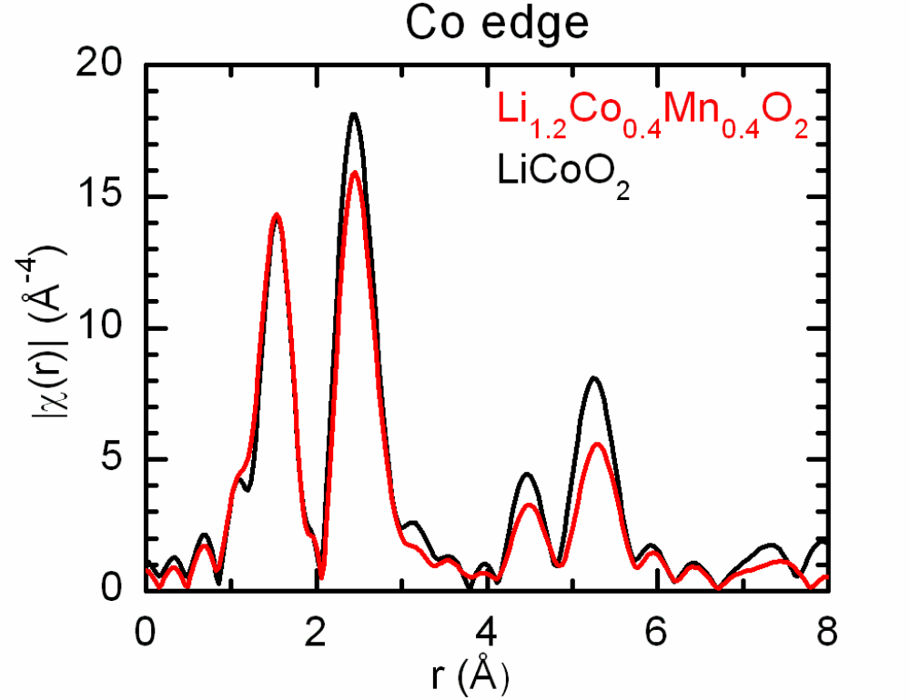
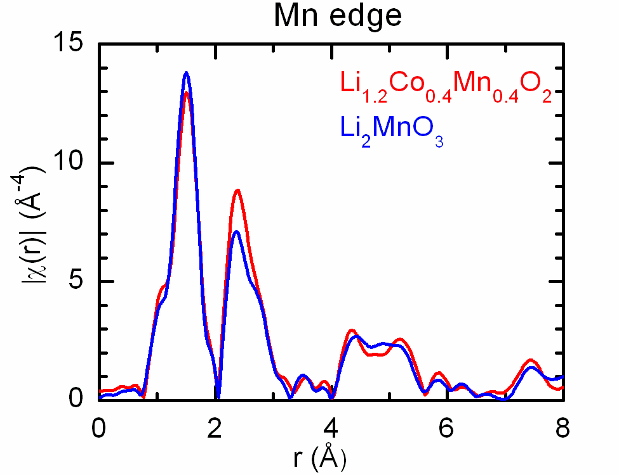
Problem:
EXAFS data suggest segregation into (almost) pure Li₂MnO₃ and LiCoO₂ regions.
Co-TM
Mn-O
Co-O
Mn-TM
Notes:
Go to "View | Header and Footer" to add your organization, sponsor, meeting name here; then, click "Apply to All"

Slide 3
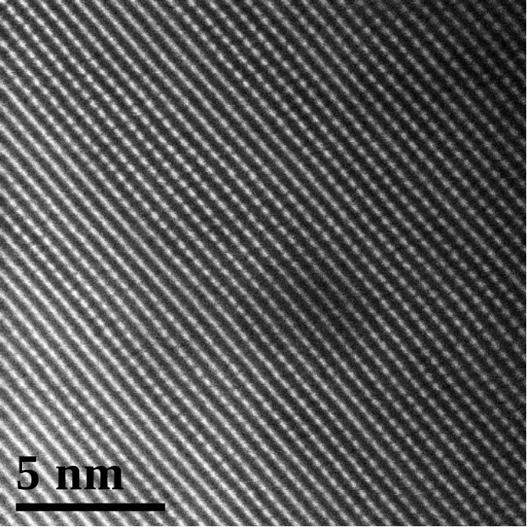
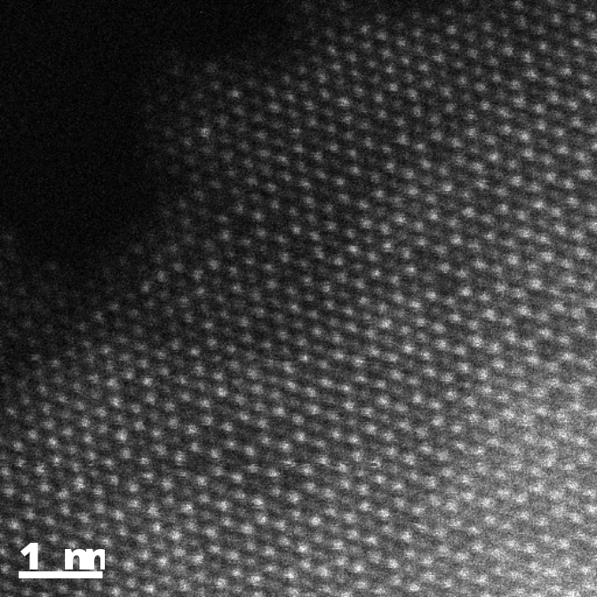
Problem:
EXAFS data suggest segregation into (almost) pure Li₂MnO₃ and LiCoO₂ regions.
HAADF data reveals coexistence of Li-ordered (dotted) and Li-disordered regions.
Li_{1.2}Co_{0.4}Mn_{0.4}O₂
Notes:
Go to "View | Header and Footer" to add your organization, sponsor, meeting name here; then, click "Apply to All"

Slide 4
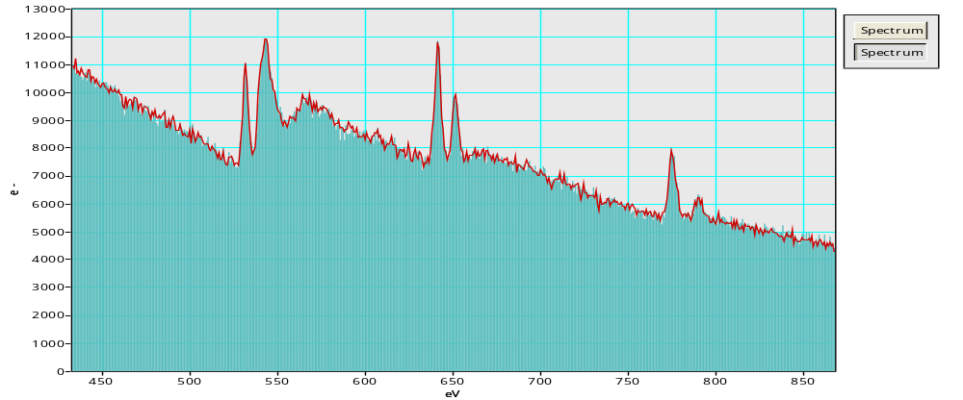
Problem:
EXAFS data suggest segregation into (almost) pure Li₂MnO₃ and LiCoO₂ regions.
HAADF data reveals coexistence of Li-ordered (dotted) and Li-disordered regions.
EELS data shows no big difference in Mn/Co ratio across both HAADF regions
Notes:
Go to "View | Header and Footer" to add your organization, sponsor, meeting name here; then, click "Apply to All"

Slide 5
The (proposed) solution
Three different length-scales in the sample:
  Segregation into LiMn₆ and Co in the < 1 nm scale. EXAFS sees these domains as bulk-like
  Intermixing of LiMn₆ and Co domains in the ~ 10 nm scale. EELS averages these domains out due to delocalization and probe-scanning effects
  Coherence of Li-sublattices of neighboring LiMn₆ domains in the order of ~ 50 nm (f.o.v. of HAADF images). Dot structures in HAADF correspond to allignment of LiMn₆ domains throughout the thickness of the sample; even if Li-columns contain ~ 50 % Co. If misalligned LiMn₆ domains are present in the observed thickness, continues fringe contrast stems from Mn-columns blocking Li-columns.

Slide 6
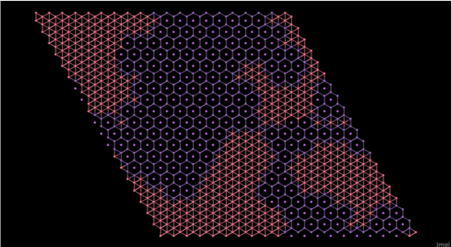
How does it look like
Construct a plausible TM plane consistent with experiment based hypothesis.
Place big enough LiMn₆ and Co domains at random places in sample.
Fill void spaces according to neighbor’s nature: domain growth preferred.

Slide 7
How does it look like
XAFS signal dominated by bulk-like atoms at interior of domains. Edge atoms account for coordination deviations from bulk values.
Each [100]_{M} column consists of ~50% Co.
EELS signal averages complete f.o.v. => Co and Mn present.

Slide 8
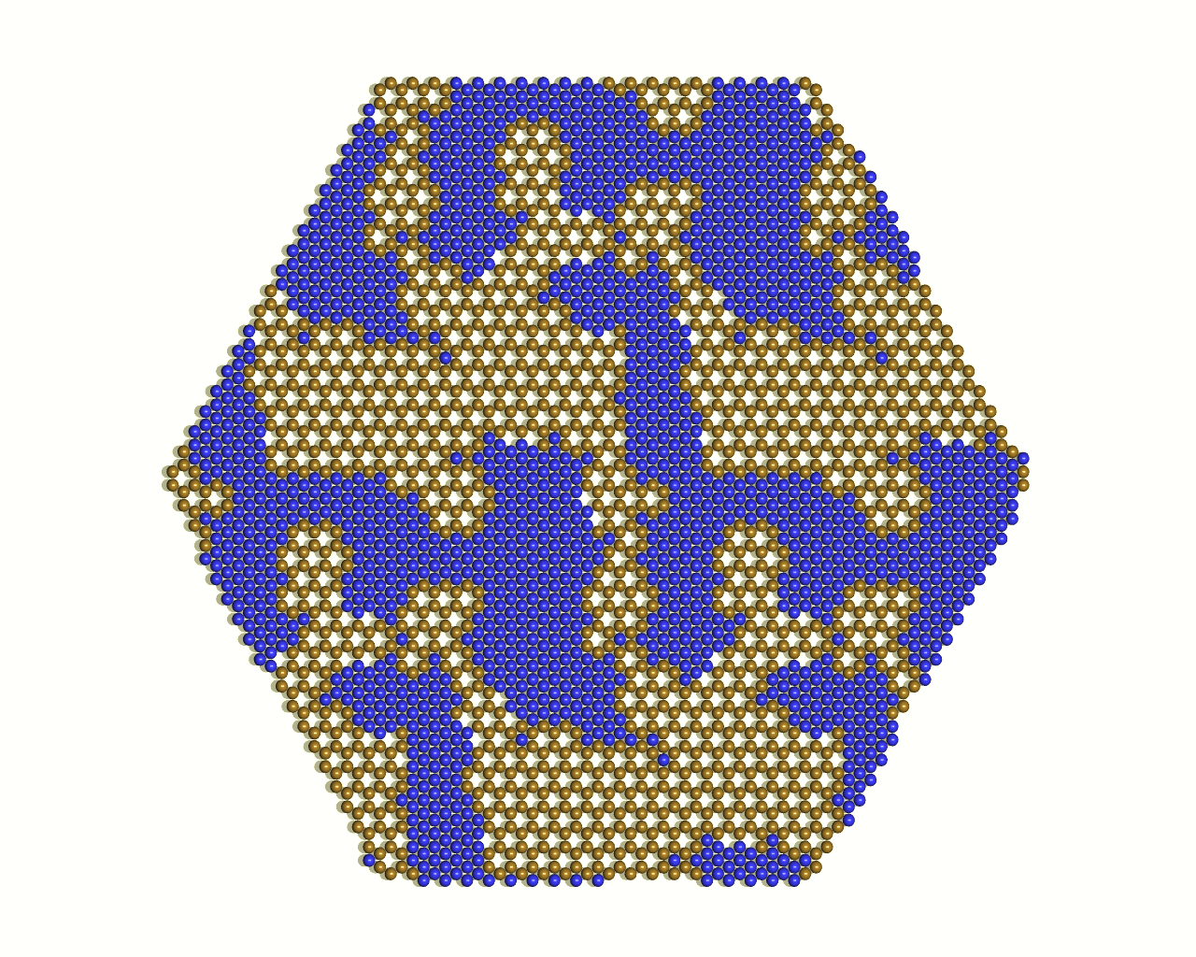
Hexagonal unit cell: better for presentation?

Slide 9
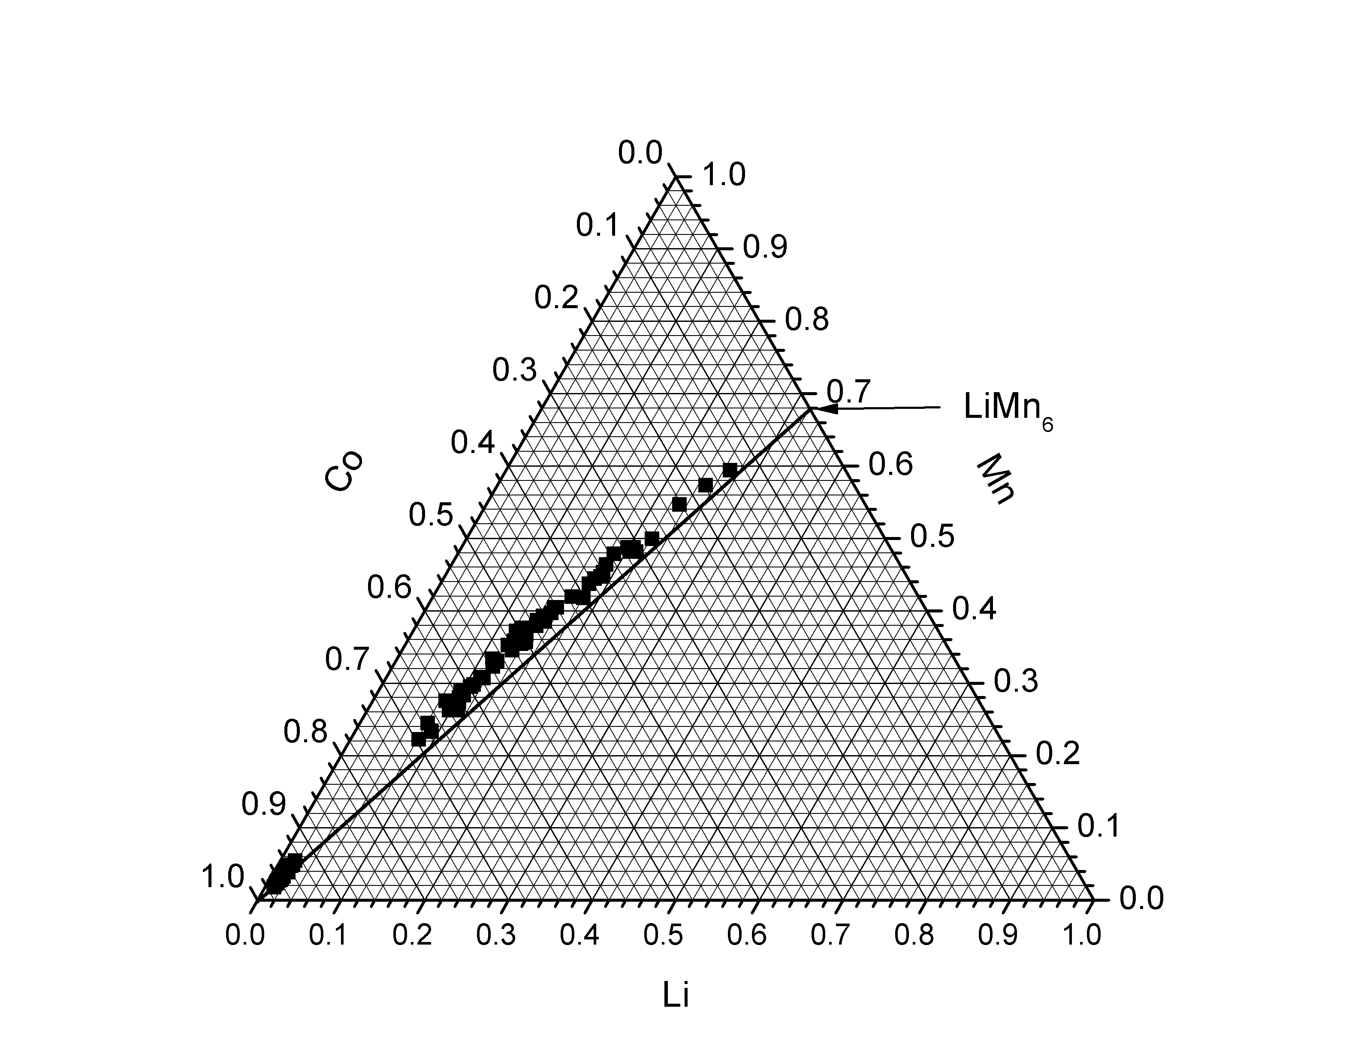
Fast turnout
Generate and analyze ~ 100 structures/min
Target composition not always achieved. Can easily be filtered out.

Slide 10
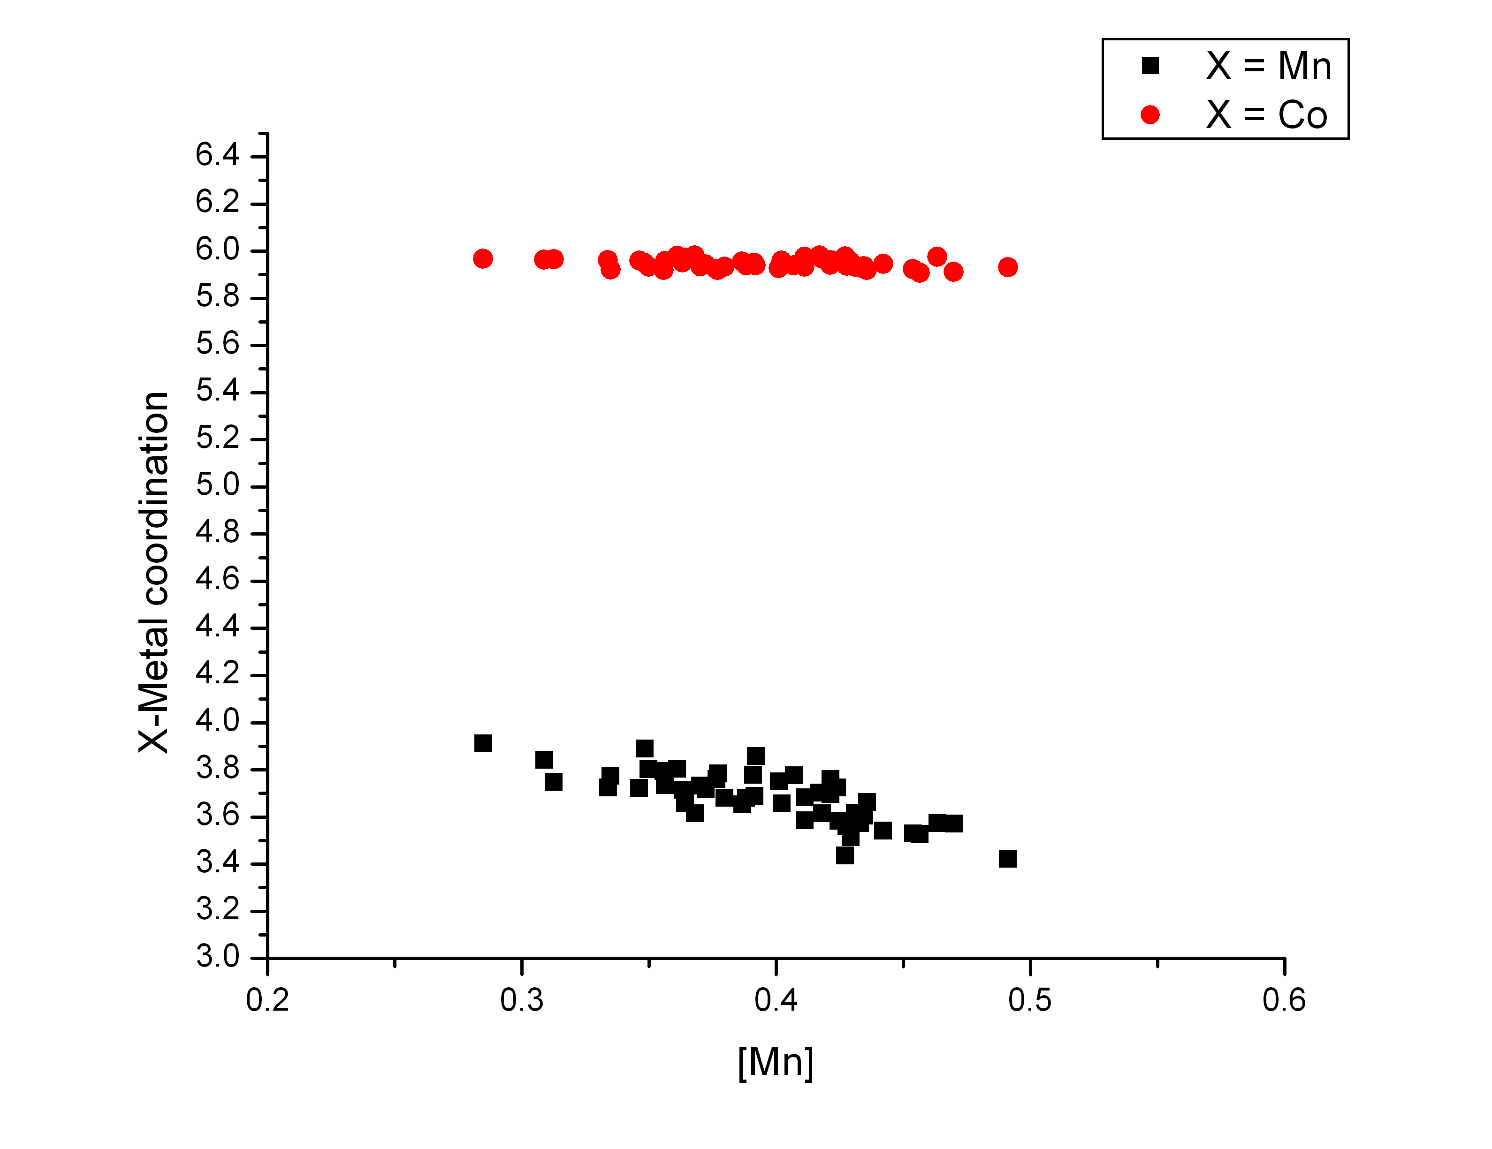
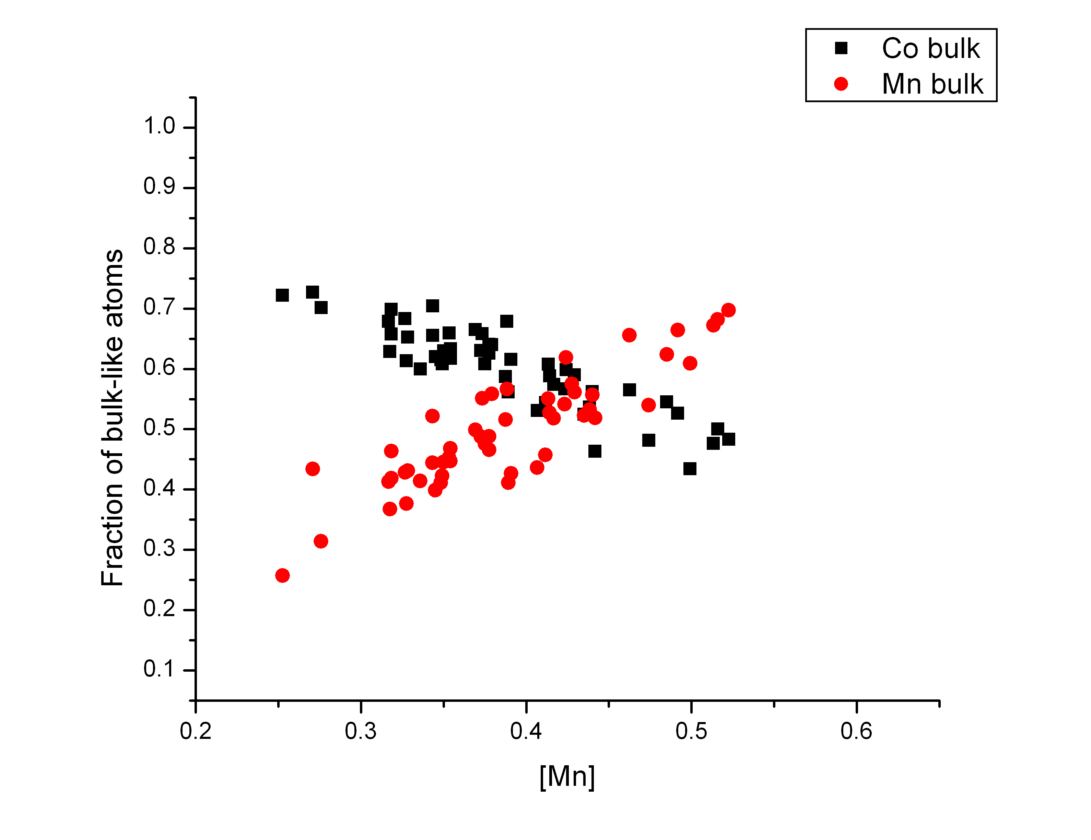
Simple analysis implemented in generation code
Can be used to obtain geometrical dependency of expected coordination, to be compared with EXAFS data.

Slide 11
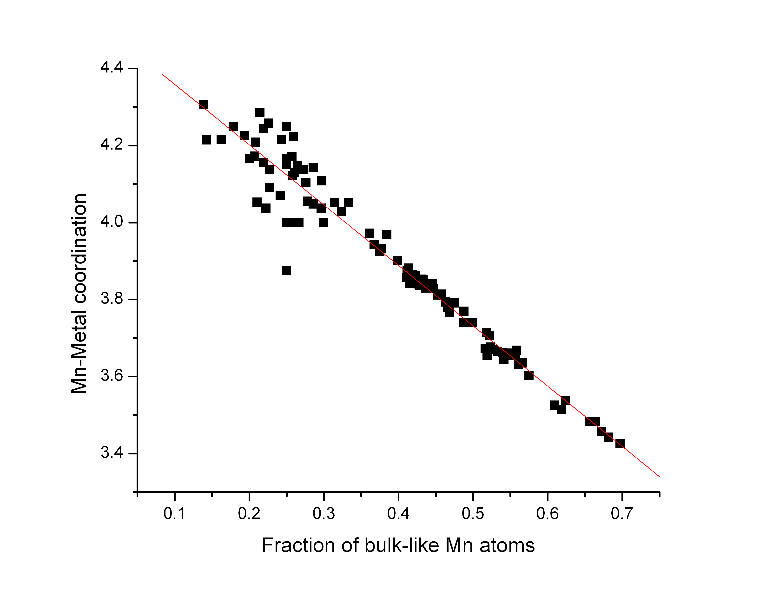
Coordination dictated by fraction of edge atoms

